Slide 1
Useful Tools for Integrating Systems
Concepts into System Change Evaluations
November 10, 2010
American Evaluation Association
Professional Development Session 34
Meg Hargreaves ● Marah Moore ● Beverly Parsons

Slide 2
Welcome and Introduction

Slide 3
Workshop Objectives
To describe a situation systemically and to understand its attributes and dynamics
To describe and understand the attributes and dynamics of a systems change intervention
To integrate systems concepts into the 4 phases of an evaluation: designing evaluation, collecting data, making meaning from data, and shaping practice

Slide 4
Four Phases of Evaluation
Design
Evaluation
Shape Practice
Collect
Data
Make
Meaning from
Data

Slide 5
Morning Agenda
Overview of systems concepts
Describing a situation systemically
Describing a systems change intervention
Design Evaluation: a systems change approach
Collect Data: selecting appropriate methods
Make Meaning: data analysis and interpretation of complex data
Shape Practice: using evaluation results

Slide 6
Systems Concepts

Slide 7
Many System Definitions
A configuration of interacting, interdependent parts that are connected through a web of relationships, forming a whole that is more than the sum of its parts (Holland 1998)
Systems are overlapping, nested, and networked; they have subsystems and operate within broader systems (von Bertalanffy 1955; Barabasi 2002)

Slide 8
Systems Thinking
A way of seeing and understanding a situation that emphasizes both the parts and the relationships among the parts rather than the parts in isolation
8
Notes:
8

Slide 9
Systems Boundaries
Delineate what is inside/outside the system or intervention, its parts, or situation of inquiry
  Geographical (location)
  Organizational (department, unit, function)
  Physical (money, materials, staff)
  Conceptual (goals, mission, purpose, rules)
  Intangibles (perceptions, awareness, mental models)
  Natural or human-made
9
Notes:
9

Slide 10
Systems Interrelationships
Relationships, connections, and exchanges among parts, whole, and environment (context)
  Social relationships, formal and informal
  Organizational relationships
  Flows of information, data, knowledge
  Funding flows, streams, budget authorizations
  Communication channels and types
  Collaborative partnerships
  Cause and effect
10
Notes:
10

Slide 11
Systems Perspectives
System perspectives or purposes that focus the energy, attention, action of system agents
System parts/agents may differ in worldviews, purposes, or agendas in a given situation
Diversity in system perspectives or purposes produces tension and energy within a system (might be productive or destructive)
Coherence of purpose or mission among parts can focus, shift patterns of system activity
11
Notes:
11

Slide 12
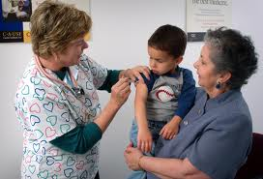
Describe This Situation Systemically

Slide 13
Partner Exercise
Pick a partner and select a situation
Describe the situation systemically
What are the boundaries?
What are the relationships?
What are key perspectives?
Your partner’s turn
13
Notes:
13

Slide 14
Schools of Systems Theory
Multiple schools of systems theory
  Cybernetics
  General systems theory
  Systems dynamics modeling
  Complexity theory
  Soft and critical systems
  Learning systems
14
Notes:
14

Slide 15
Early Cybernetics
Early leaders include Gregory Bateson, Norbert Wiener, Warren McCulloch, Margaret Mead, and Ross Ashby
Contributions
  Feedback and information
  Parallels between cognitive/human and engineered/ machine behavior
Implications for evaluation
Notes:
Overall, evaluation is grounded in the idea of feedback loops and information flow. Being intentional about this (e.g., Utilization Focused Evaluation), and looking at the role of feedback loops within the situation being studied, expand on this more explicitly.
15

Slide 16
Late Cybernetics
Leaders include Heinz von Foerster, Stafford Beer, Humberto Maturana, Niklas Luhmann, and Paul Watzlawick
Contributions
  Inclusion of observer and observed in same system
  Continuation of early cybernetics work with application to management, biology, sociology, and psychology
Implications for evaluation
Notes:
Again, the observer/observed is built into the evaluation theory and practice. This work invites us to examine explicitly the role that a specific evaluation will play within a specific context. Is the evaluation an “outsider”, assuming little contribution to changes in the system (e.g. highly controlled studies)? Is the evaluation an “insider”, explicitly designed to support the intended changes in the system (e.g. action research)? Most are somewhere on the continuum.
16

Slide 17
General Systems Theory
Leaders include Ludwig von Bertalanffy, Kenneth Boulding, Geoffrey Vickers, and Howard Odum
Contributions
  Open vs. closed systems
  Sum greater than parts
  System boundaries and webs
  Nested system hierarchies
Implications for evaluation
Notes:
Important to look at assumptions being made about these ideas.
17

Slide 18
Systems Dynamics
Leaders include Jay Forrester, Donella Meadows, and Peter Senge
Contributions
  Reinforcing and balancing feedback
  Circularity (feedback loops)
  Stocks and flows
  Computer modeling of underlying dynamics of organizational, societal, and global systems
  Mental models and system archetypes
  Levels of system leverage
Implications for evaluation
Notes:
18

Slide 19
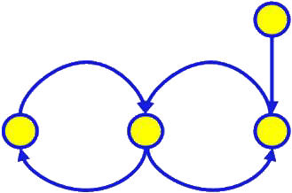
Feedback Loops

Slide 20
Complexity Theory
Leaders include Ilya Prigogine, John Holland, Stuart Kauffman, and James Lovelock
Contributions
  Based on cybernetics and general systems theory
  Complex adaptive systems
  Conditions of self-organization—far from equilibrium
  Irreversible past, unpredictable future
  Nonlinearity (small initial differences—large effects)
  Adaptation and co-evolution
Implications for evaluation
Notes:
20

Slide 21
Multiple Systems Dynamics
Multiple Dynamics Concurrently Exist in Systems
Unorganized—random
Organized—simple
Organized—complicated
Self-organizing—complex adaptive
Select dynamics to attend to in evaluation
21
Notes:
21

Slide 22
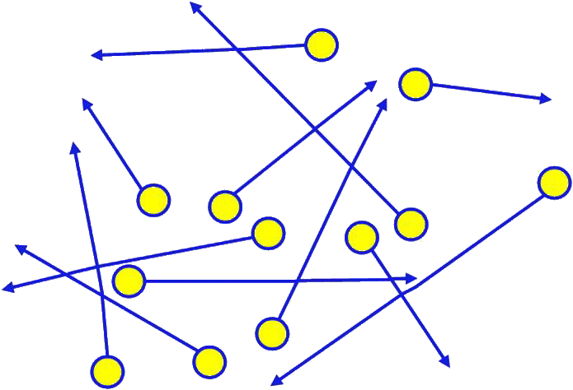
Random Independent Actions

Slide 23
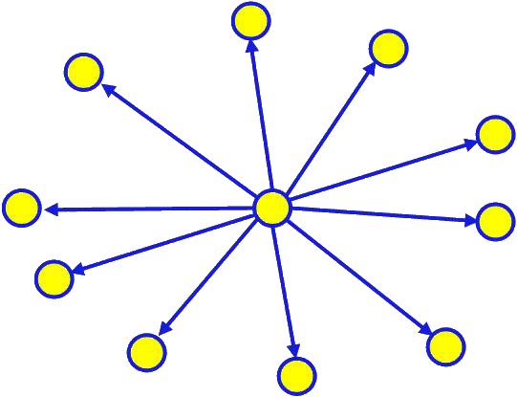
Simple Dependent Relationships

Slide 24
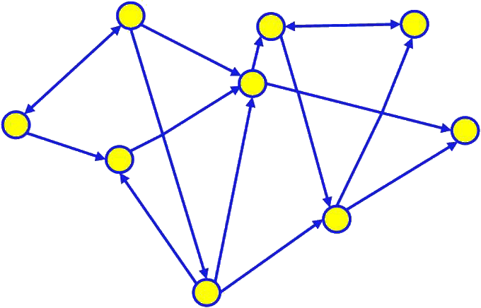
Complex Interdependencies

Slide 25

Dynamics of a Social System and Its Context
Context
Low Agreement
Unorganized (random)
Self-Organizing
(complex, adaptive)
Perspectives
Organized
(simple, complicated)
High Agreement
High Predictability
Relationships
Low Predictability

Slide 26
Soft and Critical Systems
Leaders include C. West Churchman, Russell Ackoff, Peter Checkland, Werner Ulrich, and Michael C. Jackson
Contributions
  Applications in management and public policy
  Multiple perspectives and power; boundary critique
  Addressing intractable problems/situations
Implications for evaluation
Notes:
26

Slide 27
Learning Systems
Systems of learning in individual practice, groups, and organizations
Leaders include Kurt Lewin, Eric Trist, Chris Argyris, Donald Schon, Mary Catherine Bateson
Contributions
  Way people learn (in organizations, primarily) and systems within which they learn
  Group dynamics
  Action research
Implications for evaluation
Notes:
27

Slide 28
Systems Change Interventions

Slide 29
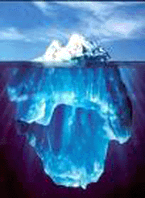
The Systems Iceberg
Events and Behaviors
What is happening now?
Patterns
How do patterns play out over time and space?
Structures
Paradigms Conditions
What are the drivers and deep structures? How are they related?
M.Hargreaves, mhargreaves@mathematica-mpr.com; M.Moore, marah@i2i-institute.com; P.Parsons, bparsons@insites.com

Slide 30
What Is Systems Change?
Underlying patterns and structures influence system-wide behaviors
System change—shifts in patterns and paradigms/structures/conditions of the system
These shifts manifest as changes in boundaries, relationships, perspectives, and dynamics over time and space
These changes influence and are influenced by changes in events and behaviors

Slide 31
What Is the Nature of the Intervention?
What is the intervention’s governance—its funding, management, organizational structure, and implementation?
What is the intervention’s theory of change—its causal mechanisms and pathways of change related to deep structures, patterns, and events and behaviors?
What are the intervention’s intended outcomes—how many, how focused, and at what levels?

Slide 32
Intervention Theory of Change
System Intervention theory of change
  How an intervention plans to trigger the system change process (Funnell and Rogers 2010)
Some interventions focus on changing complex systems
Some interventions focus on changing individuals operating within complex systems
Both approaches benefit from a theory of change (TOC) that attends to different aspects of the system
32
Notes:
32

Slide 33
Example: City Integration Initiative

Slide 34
What Is the Situation?
Describe the situation—the whole, parts, and boundaries
Describe the dynamics of the situation’s relationships (where are dynamics random or unknown, simple, complicated, or complex)
Describe the diversity of purposes or perspectives within the situation
How do deep structures, patterns, and events and behaviors factor into the situation?
34
Notes:
34

Slide 35
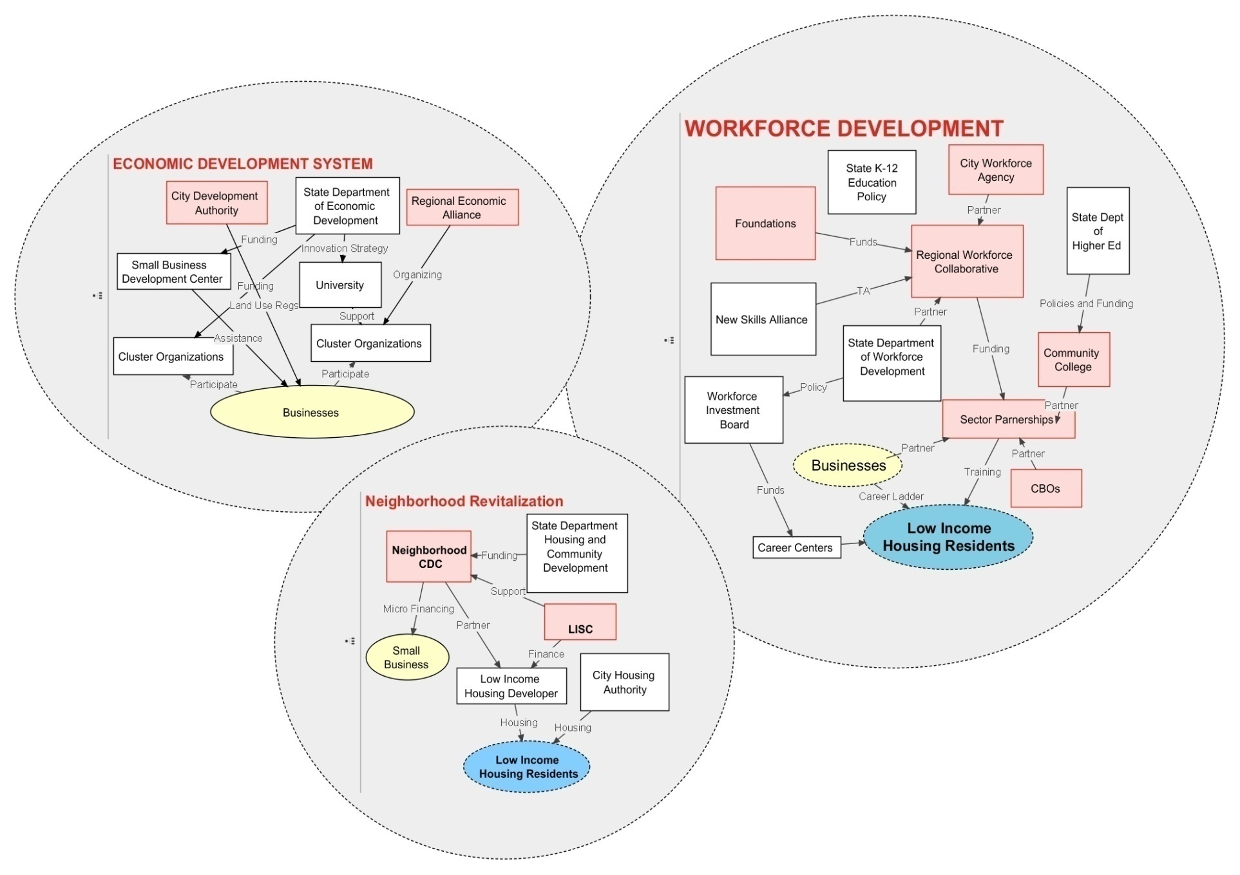
Current Situation: Independent Systems
Current Situation: Independent Systems
Source: Mount Auburn Associates and Mathematica Policy Research
M.Hargreaves, mhargreaves@mathematica-mpr.com; M.Moore, marah@i2i-institute.com; P.Parsons, bparsons@insites.com 35

Slide 36
What Is the Intervention?
What is the intervention’s governance—its funding, management, organizational structure, and implementation?
What is the intervention’s theory of change—its causal mechanisms and pathways of change?
What are the intervention’s intended outcomes—how many, how focused, and at what levels?
How does the intervention attend to deep structures, patterns, and events and behaviors?

Slide 37
Goal: Successful models are developed that can inspire a new generation of effective urban investment and transformation to the benefit of urban, low income residents.
INDIVIDUAL SITES
CITIES
YEAR 10
Low income individuals and families in 5 cities have
improved outcomes in terms of income, assets and
skills/education.
Low income individuals and families in urban
neighborhoods in the US have improved outcomes in
terms of income, ssets and skills/education
Repayment of
capital
Long-Term
Outcomes
System Outcomes: changes
in relationships, policies,
and capacities
Learning from sites
contributes models
and policies
Achieving Scale
Lenders
invest
differently
Federal, state
and local
policy
changes
implemented
Models and
practice
applied in
other cities
Philanthropic
support is
influenced by
knowledge
YEAR 6
Site-specific
outcomes
achieved
Intermediate
Term Outcomes
Specific operational and
financing changes indicating
new patterns of system
behavior
Increased and/or aligned
investment in 5 cities by
LC Funders
LC and its Members;
refined investment
strategies based
on learning
Absorption of
knowledge
Traction and
Momentum
Multiple types and sources of funding blended & deals closed
Locally embedded CDFI with increased capacity to raise & deliver capital
Varied practices
reflect LC values
Policy barriers
identified &
addressed
Neighborhoods more connected to city & region
More connections across disciplines and across stakeholder groups
YEAR 3
LEARNING
Knowledge in the field is built based on
the successes and failures of the
site activities
Projects and program outputs achieved
Short-Term
Outputs &
Outcomes
New financial products developed and leverage sources identified
LEARNING
National evaluation
plan utilized
State / national policy
barriers identified & addressed
System capacity needs identified & addressed
Peer learning sessions implemented
CDFI integrated in program structure
Multi sector
leadership
engaged
Partnerships
established
or expanded
Joint
planning
undertaken
Contextual
dynamics
surfaced
Local
evaluation
utilized
Implementation & System Building
PLANNING
Cities assistance in finalizing the application
Community Inputs
Living Cities Inputs
Living Cities Members
Local Funds
Local Learning
Local Leadership
Policy
Grants
Capital
Framing
Learning: TA and Evaluation
Policy
Communications
Investments
Leadership

Slide 38
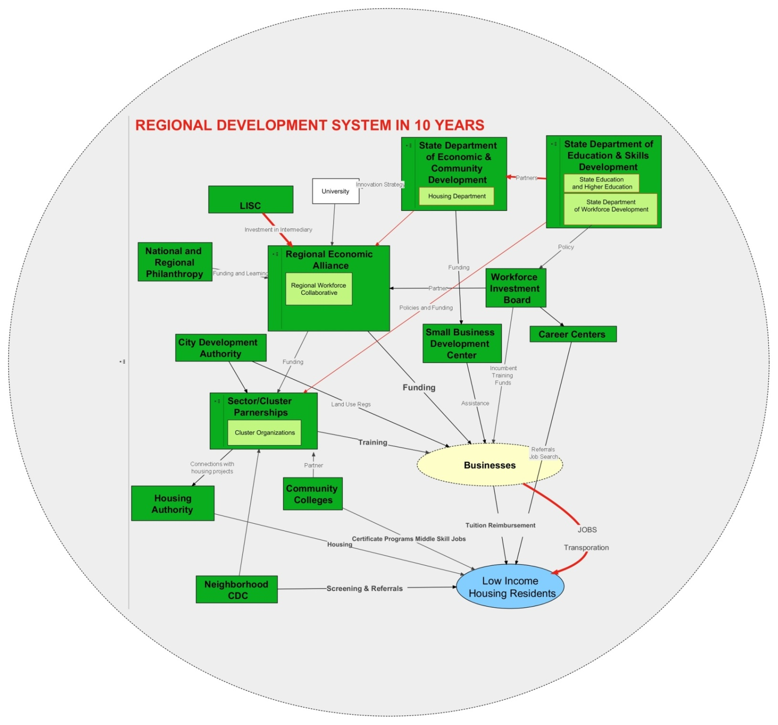
System Change: Integrated System
Source: Mount Auburn Associates and Mathematica Policy Research

Slide 39
What Is the Evaluation’s Design?
Who are the evaluation’s users?
What are the evaluation’s purposes? (developmental, formative, monitoring, or summative)
What are the evaluation’s research questions?
What are the evaluation’s methods?
How will the data be analyzed and interpreted?
How does the evaluation attend to deep structures, patterns, and events and behaviors?

Slide 40
What Is the Evaluation’s Purpose?
Who are the evaluation’s users?
The national client, initiative’s funders, local grantees, and other stakeholders
What are the evaluation’s purposes?
The evaluation will focus on the intervention’s development and early implementation, providing formative feedback at multiple levels

Slide 41
What Are the Evaluation Questions?
What systems changes are occurring?
  How have the system’s boundaries been expanded or reconfigured?
      Geographic boundaries, stakeholder groups, discipline areas
  Have stakeholders’ perspectives changed?
      Orientation of problem, understanding of challenges and opportunities, commitment to project, charge attitudes
  Have intensity, types of relationships changed?
      Level of coordination, formality of linkages, flow of resources, closeness of ties, diversity of actors

Slide 42
What Are the Evaluation Questions?
What is the role of the client in influencing systemic change and benefits for low-income people?
      Integration of financing and programmatic strategies, how blended funds are structured, introduction of new financial intermediary, client consultation and technical assistance
How has the community’s context interacted with and influenced systemic change and benefits for low-income people?
      Economic conditions, racial dynamics, political environment, community norms, cultural norms

Slide 43
What Are the Evaluation Questions?
How are site-specific strategies, activities, and structures influencing systemic change and benefits to low-income people?
      Site strategies and projects
      Initiative staffing, management, governance structure
      Common agenda
      Capacity and structure of financing partners
      Leadership of stakeholders
      Public sector role and leadership

Slide 44
Evaluation Methods for Unknown Dynamics
Case studies, interviews, focus groups, observation of activities
Mapping of community assets
Environmental scans
Needs assessments
Situational analyses

Slide 45
Evaluation Methods for Simple Dynamics
Randomized experiments
Quasi-experimental comparisons
Regression discontinuity analyses
Hierarchical linear modeling
Performance measurement, monitoring
Program audits, inspections

Slide 46
Evaluation Methods for Complicated Dynamics
Computer simulation models of stocks, flows, feedback, and causal loops
Social network analysis
Pre-post measurements of change
Interrupted time series analysis
Comparative measurement and monitoring

Slide 47
Evaluation Methods for Complex Dynamics
GIS spatial analysis
Agent-based modeling
Time trend analysis
Observational or cross-sectional studies
Retrospective analysis
Adaptive learning measurement systems

Slide 48
What Are the Evaluation’s Methods?
Network analysis—social network surveys and ecosystem mapping of sites
Key informant interviews—phone interviews and periodic calls with site-based informants
Site visits—focus groups, on-site interviews
Observation—of program activities, events
Document review—program documents, products
Secondary data—environmental indicators

Slide 49
Data Analysis and Interpretation
Network survey—two rounds
Follow-up site visits and interviews
Tracking of grantee-level policy changes
Tracking indicators of grantee outputs, project-specific , city-level, and resident outcomes
Spatial analysis of neighborhood, city, and region change
49

Slide 50
Group Exercise
Select a systems change initiative and describe:
The dynamics of the situation
The dynamics of the intervention
The evaluation’s design—users, purpose, questions, methods, and analyses
How does the design address each level of the iceberg?
How do systems concepts and dynamics change the design?
50
Notes:
50

Slide 51
Summary of Morning Session
51
Notes:
51

Slide 52
Setting the Stage for the Afternoon

Slide 53
The Afternoon Will:
Build on concepts from the morning
Look at paradigm shifts in systems change
Explore the Iceberg
Present three tools that can help with your work
We will begin promptly at 12:00
Enjoy your lunch!!!

Slide 54
Afternoon Agenda
Using another evaluation example, explore:
  Paradigm shifts in evaluation
  Building a theory of change around systemic points of influence
  Assessing patterns that connect deep structures with events and behaviors
Three new tools
Group work
Close

Slide 55
Example: Quality Improvement Center for Early Childhood (QIC-EC)

Slide 56
Revisiting the Systems Iceberg
Events and Behaviors
What is happening now?
Patterns
How do patterns play out over time and space?
Structures
Paradigms Conditions
What are the drivers and deep structures? How are they related?
M.Hargreaves, mhargreaves@mathematica-mpr.com; M.Moore, marah@i2i-institute.com; P.Parsons, bparsons@insites.com

Slide 57
QIC-EC: Situation
Many interventions in place, but abuse and neglect rates not improving
Multiple partners related to child abuse and neglect (CAN) prevention (programs, communities, policymakers, researchers, etc.)
Affects families across socioeconomic spectrum
Social norms stigmatize families who are thought to be at risk
Families are isolated socially and isolated from the larger system
Predominantly focuses on reducing risk and individual behavior change rather than more systems approach
No underlying paradigm driving policy—policy often not related to CAN paradigms at all!
57
Notes:
57

Slide 58
QIC-EC: Intervention
Goals:
Decrease in child abuse and neglect through a systemic paradigm shift from focusing on risk to building PROTECTIVE FACTORS in families and communities
Move to a focus on identifying and understanding patterns across the systems and the paradigms, structures, and conditions that reinforce and/or support change in the patterns
58
Notes:
58

Slide 59
QIC-EC: Intervention
Strategies:
Research project focused on creating and integrating new knowledge about using Protective Factors in CAN prevention
Overall project focused on a systemic approach across multiple levels
Four research demonstration sites
  Different approaches to CAN prevention
  Different levels of systems involvement and integration
  Varying degrees of integrating protective factors into interventions
59
Notes:
59

Slide 60
QIC-EC:
Protective Factors as Paradigm Shift
Parental resilience
Social connections
Concrete support in time of need
Knowledge of parenting and child development
Social and emotional competence of child
60
Notes:
60

Slide 61
QIC-EC: Intervention
The Theory of Change identifies “Points of Influence” at multiple levels:
Caregiver-Child (individual level)
Social Support (relationship level)
Neighborhood (community level)
Organizational Programs (community level)
Policy and Social Norms (“systems” level)
61
Notes:
61

Slide 62
QIC-EC: Intervention
Points of Influence in the Theory of Change are subsystems that:
Have their own coherence
Interact with other subsystems
Change in different ways or rates
Past research shows system impact
62
Notes:
62

Slide 63
QIC-EC: Intervention
At each level, the TOC identifies:
Baseline of fundamentals and system dynamics
Testing applications of new fundamentals and system dynamics
Tipping point to new fundamentals and system dynamics balance
Sustaining an adaptive balance of new fundamentals and system dynamics in a shifting context
63
Notes:
63

Slide 64
QIC-EC: Intervention
A tool for understanding the paradigms/structures/conditions that influence events and behaviors
64
Notes:
64

Slide 65
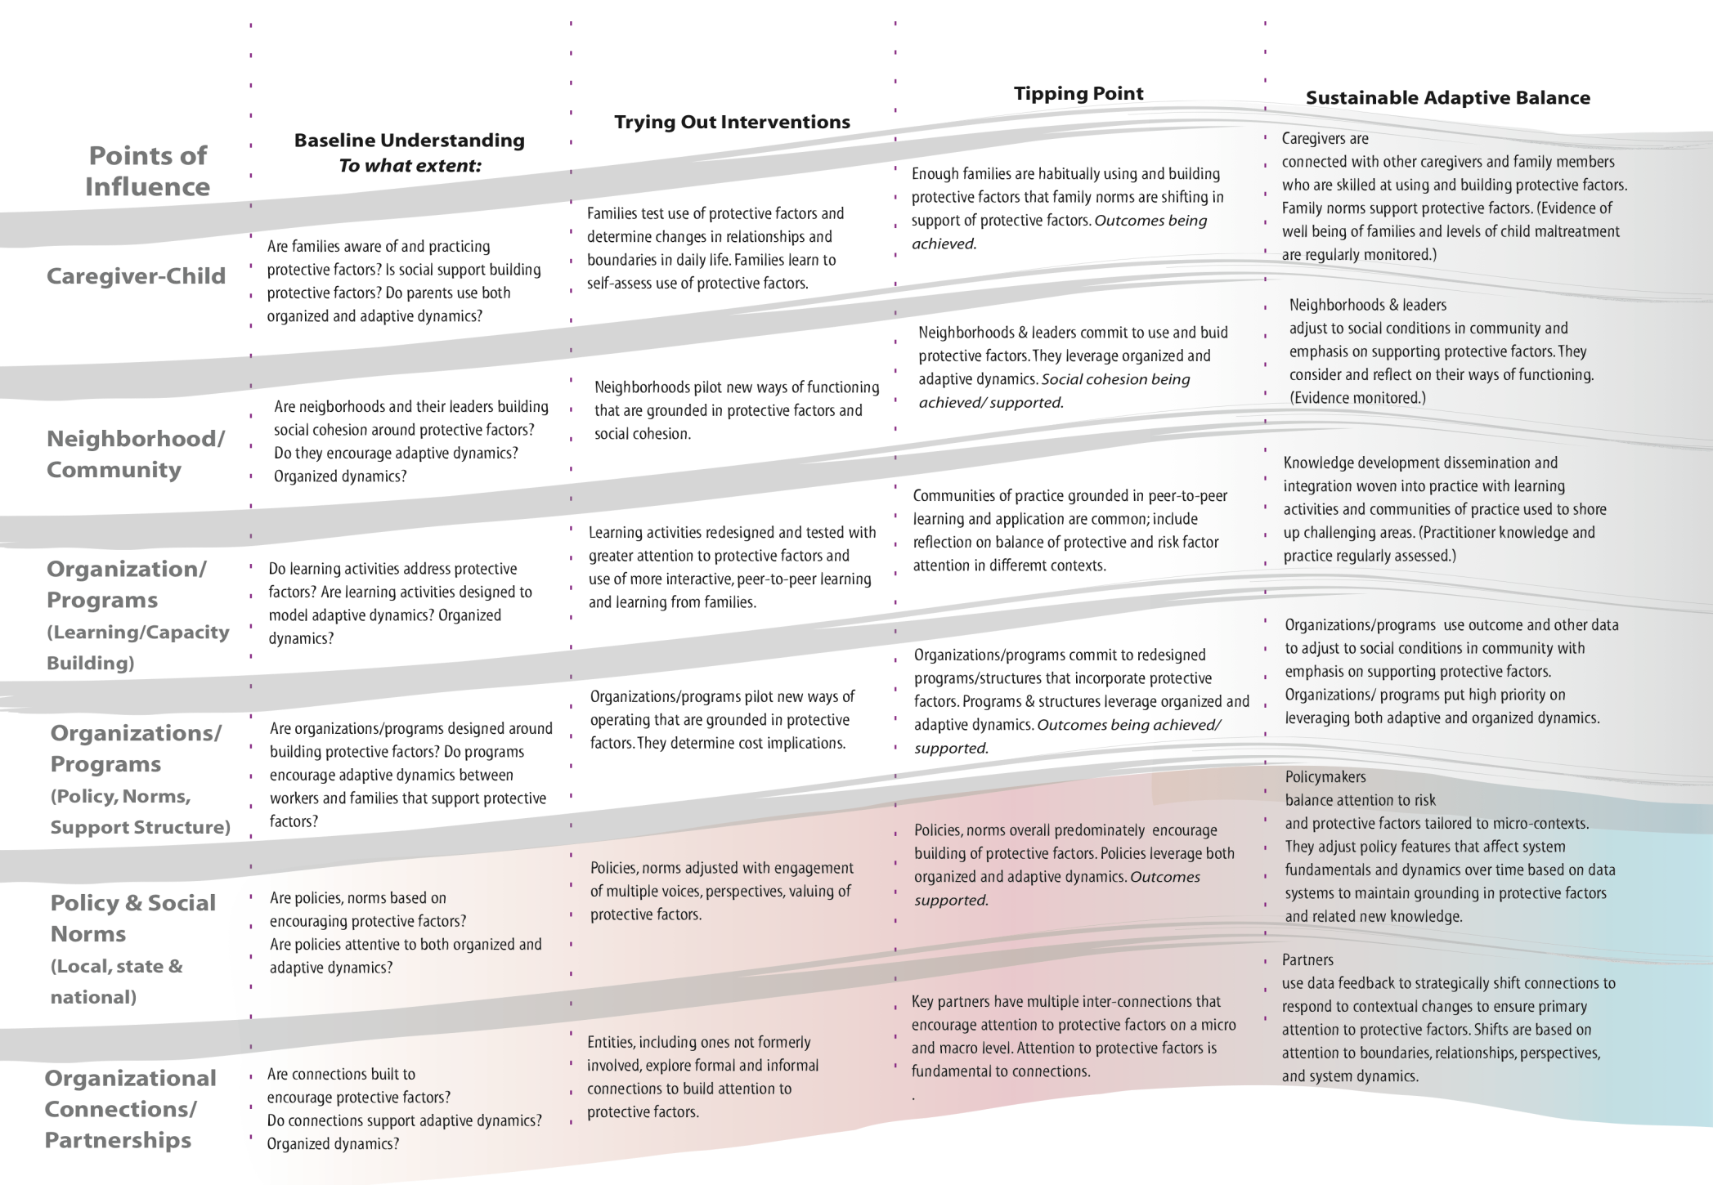
Theory of Change in Paradigms, Structures, and Conditions of Complex Systems
Example from Cross-Site Evaluation of Quality Improvement
Center on Early Childhood
M.Hargreaves, mhargreaves@mathematica-mpr.com; M.Moore, marah@i2i-institute.com; P.Parsons, bparsons@insites.com 65
Notes:
Evaluation from a Self-organizing Versus Predictive Systems Perspective: Examples from the Field
11/8/2010
AE.07.SOvsPSPrsntn.10-24.ppt
65

Slide 66
Group Activity (20 minutes)
Use the example you worked on this morning
Identify the systemic points of influence (paradigms/structures/conditions)
Identify what the “sustained adaptive balance” would look like for these points of influence

Slide 67
Four Phases of Evaluation
Design
Evaluation
Shape Practice
Collect
Data
Make
Meaning from
Data
Figure 1. Phases of Evaluation
67
Notes:
67

Slide 68
Evaluation Design

Slide 69
QIC-EC: Evaluation Design
Two levels of Evaluation:
Individual Research Demonstration Sites
Cross-Site
These levels are separate but interrelated:
Both shared and separate methods
Results from each expected to inform the other
Ongoing communication
69
Notes:
69

Slide 70
“Insider-Outsider” Evaluation: A Creative Tension
The extent to which evaluation process and evaluation results explicitly contribute to an intervention varies widely (e.g., action research vs. “pure” research)
For the QIC-EC, this is a tension
In complex systems tensions do not always need to be resolved!

Slide 71
QIC-EC: Cross-Site Evaluation Design
Purpose:
Increase understanding of the movement toward and results of a paradigm shift in CAN prevention
Identify interrelationships between “points of influence” in development and implementation of CAN prevention interventions
Identify how protective factors are built with families and within communities and programs
Identify the role of protective factors in CAN prevention
71
Notes:
71

Slide 72
QIC-EC: Cross-Site Evaluation Design
Users:
QIC-EC Leadership Team
QIC-EC Learning Network
Four research demonstration projects
The “field”
72
Notes:
72

Slide 73
QIC-EC: Cross-Site Evaluation Design
Overall Approach:
Use a systemic TOC to design the evaluation
Move from simply evaluating the efficacy/effectiveness of interventions in changing events and behaviors to evaluating:
  The effect of systemic patterns and underlying structures on CAN
  Effectiveness of efforts to change systemic patterns and underlying structures
Test specific models at individual sites and then layer additional evaluation methods on top of that for Cross-Site
73
Notes:
73

Slide 74
QIC-EC: Cross-Site Evaluation Design
Methods:
Randomized Controlled Trial (RCT) and Quasi-Experimental (QE) (at project level)
Cross-site incorporates data from project-level RCTs/Q-E
Structural Equation Modeling to integrate data from multiple levels
74
Notes:
74

Slide 75
QIC-EC: Cross-Site Evaluation Design
Methods (cont.):
Mixed methods—both in tandem and in parallel
  Various quantitative measures for caregiver/child-level outcomes
  Quantitative and qualitative measures at other levels
  Qualitative exploration of intervention implementation leading to quantitative measures
  Social Network Mapping to understand relationships at the caregiver/child level, the community level, and the program level
75
Notes:
75

Slide 76
QIC-EC: Cross-Site Evaluation Design
Using the Theory of Change in Paradigms, Structures, and Conditions of Complex Systems tool to identify systems outcomes for points of influence
76
Notes:
76

Slide 77
Theory of Change in Paradigms, Structures, and Conditions of Complex Systems
Example from Cross-Site Evaluation of Quality Improvement
Center on Early Childhood
M.Hargreaves, mhargreaves@mathematica-mpr.com; M.Moore, marah@i2i-institute.com; P.Parsons, bparsons@insites.com 77
Notes:
Evaluation from a Self-organizing Versus Predictive Systems Perspective: Examples from the Field
11/8/2010
AE.07.SOvsPSPrsntn.10-24.ppt
77

Slide 78
QIC-EC: Cross-Site Evaluation Design
“Sustained adaptive balance” for the QIC-EC points of influence

Slide 79
Group Activity (15 minutes)
Use the same example
Identify what the “sustained adaptive balance” would look like for the points of influence

Slide 80
QIC-EC: Cross-Site Evaluation Design
A tool for understanding the patterns in how paradigms/structures/conditions influence events and behaviors
80
Notes:
80

Slide 81
7 Cs Framework
The 7 C’s Framework
Understanding Patterns

Slide 82
QIC-EC: Cross-Site Evaluation Design
Paradigm Shift as a Social Movement
82
Notes:
82

Slide 83
Change Agent
Social Change Movement
Systems Change
Loosely organized, collective systems change effort by people or organizations with a common purpose and solidarity in sustained interactions with the systems they are focused on changing
QIC-EC
Changes in Systemic Points of Influence
Impact
Reduction of CAN
M.Hargreaves, mhargreaves@mathematica-mpr.com; M.Moore, marah@i2i-institute.com; P.Parsons, bparsons@insites.com

Slide 84
QIC-EC:
Paradigm Shift and Social Movements
Feeding the Social Movement:
At individual Sites
  Collaborations
  Sharing of process and outcomes
  Learning through research and evaluation
Across the “field”
  New knowledge dissemination through QIC-EC
  Broad dissemination of results
  Informal dissemination

Slide 85
Group Activity (30 minutes)
Continue with the same example
Identify how you might use the 7 Cs to understand the relevant patterns in the movement toward a “sustained adaptive balance” for the “points of influence”
Pick one example that would look at the change agent level; one for the social movement; and one for the systems change
How does this help you to understand change in events and behaviors?

Slide 86
Small Group Discussion and
Report Out
One important thing that you learned this afternoon using the two tools for evaluation design
One thing that you will do differently in your practice
One question with which you are leaving

Slide 87
How are you integrating systems thinking into your approach?

Slide 88
ZIPPER
Z = ZOOMING IN AND OUT OF EVALUAND AND ITS ENVIRONMENT
I = INTERCONNECTING THE PARTS
P = PLUNGING INTO PARADIGMS, STRUCTURES, AND CONDITIONS
P = PERCEIVING PATTERNS
E = ENVISIONING ENERGY
R = RECOGNIZING RESULTS

Slide 89
Wrap-Up Discussion and
Session Evaluation

Slide 90
Contact Information
Margaret Hargreaves
  mhargreaves@mathematica-mpr.com
  617-301-8994
Marah Moore
  marah@i2i-institute.com
  575-758-7513
Beverly Parsons
  bparsons@insites.org
  www.insites.org
  360-638-1442; 970-226-1003

Slide 91
QIC-EC:
Implications for Data Collection
How integrated is the evaluation with the intervention?
How are stakeholders from different levels involved?
What is the timing and frequency of data collection, based on the TOC?

Slide 92
QIC-EC:
Implications for Making Meaning
How integrated is the evaluation with the intervention?
How are stakeholders from different levels involved?
How are different needs/purposes balanced?

Slide 93
QIC-EC:
Implications for Shaping Practice
How integrated is the evaluation with the intervention?
How are stakeholders from different levels involved?
Who is trying to shape whose practice?

